Slide 1


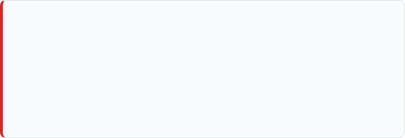
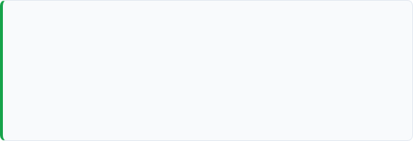
Approval-Gated IT Operations Assistant
Safe, deterministic IT operations workflow using LangGraph
Problem
Solution
Operational actions such as service restarts can be highly risky when executed without strict validation, authorization controls, and mandatory human oversight. Autonomous LLMs acting directly on infrastructure introduce non-deterministic hazards.
•
Deterministic validation & permission checks
•
Context retrieval & execution planning
•
Human approval gate before high-impact operations
•
Mocked execution & post-action verification
Safety Guarantee: All operations utilize synthetic data and mocked tools only. Zero production risk.
User Request
Validation
Human Approval
Safe Execution
Verification
Approval-Gated IT Operations Assistant
Python + LangGraph StateGraph

Slide 2
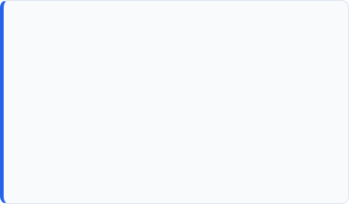

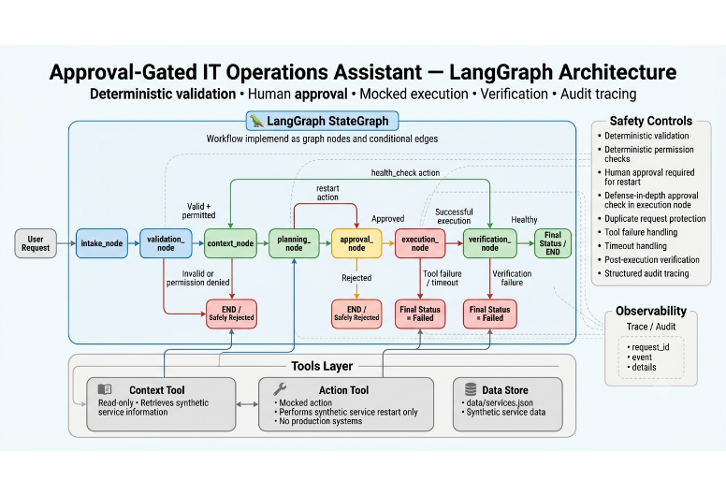
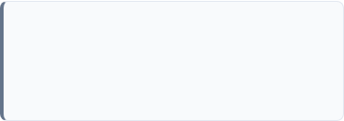

LangGraph Architecture
Core StateGraph Mechanics
• Nodes: Represent explicit workflow stages (intake, validation, planning, approval, execution, verification).
• Conditional Edges: Control safe routing (e.g., rejection paths, health-check shortcuts).
• AgentState: Immutable context carrying request details, status, and audit traces across nodes.
Tools Layer & Storage
Context Tool: Read-only synthetic info retrieval
Action Tool: Mocked service restart handler
Data Store: data/services.json
Branching paths immediately terminate execution on invalid input, permission failure, or human rejection.
Approval-Gated IT Operations Assistant
Python + LangGraph StateGraph

Slide 3

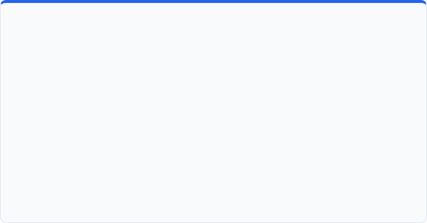
Safety & Reliability
Human Approval & Defense-in-Depth
Deterministic Controls & Error Handling
•
Mandatory Approval Gate: Service restart actions strictly cannot proceed without explicit human approval token.
•
Deterministic RBAC: Permission decisions rely on strict rules, avoiding non-deterministic LLM evaluation for access.
•
Graph Routing Enforcement: Conditional edges bypass execution entirely if approval status is rejected.
•
Duplicate Protection: Prevents repeated action submission via request idempotency tracking.
•
Defense-in-Depth: execution_node performs an independent internal re-verification of human approval state prior to invoking tools.
•
Fail-Safe Execution: Tool failures and timeouts trigger immediate transition to Final Status = Failed.
•
Post-Action Verification: Automatic post-execution health check confirms state before declaring success.
Approval-Gated IT Operations Assistant
Python + LangGraph StateGraph

Slide 4


Testing & Observability
Automated Test Suite
Structured Trace in AgentState
Happy Path
Approval Rejection
Invalid Input
Permission Failure
Duplicate Request
Tool Failure
"Every workflow stage records structured audit events for full end-to-end traceability."
Timeout Handling
Missing Approval
Comprehensive Validation: Tests cover every graph branch, conditional edge, error edge case, and defense-in-depth safety assertion.
Approval-Gated IT Operations Assistant
Python + LangGraph StateGraph

Slide 5

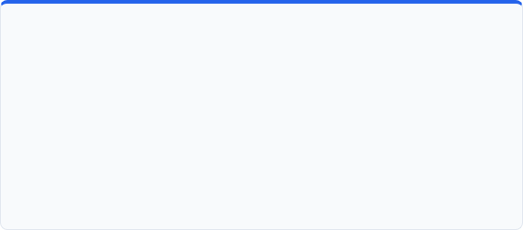
Trade-offs & Future Improvements
Design Trade-offs
Production Roadmap
•
Safety over Autonomy: Deterministic routing prioritizes predictability over autonomous decision-making.
•
• Persistent LangGraph Checkpoints & State Persistence
•
• Production AuthN/AuthZ (OAuth2 / OIDC + SAML)
•
Human Friction: Mandatory approval adds operational delay but significantly mitigates outage risk.
•
• OpenTelemetry & Datadog observability integration
•
• Secure LLM / AWS Bedrock adapter for query parsing
•
Mocked Scope: Uses synthetic data and mocked tools to ensure safety during assessment without touching production infra.
•
• Automated retry policies & durable idempotency store
•
• Direct integration with ServiceNow / PagerDuty / Kubernetes API
Core Design Principle: Automation should accelerate operations without bypassing human control.
Approval-Gated IT Operations Assistant
Python + LangGraph StateGraph

